Slide 1

Day 2:
Link in Bio
Introduction
Notes:
Photo by Le Buzz Studio on Unsplash

Slide 2

Your 6-Day Success Plan
You have done this!
Day 0 (30 mins):
Roadmap to Software Dev
Learn the pros of being software dev
Learn the step by step to be software dev

Slide 3
Your 6-Day Success Plan
You also have done this!
Day 1 (1h):
Learn creating a website using HTML
Create Your First Website
Understand how websites understand HTML
Use HTML to create links & texts
Build a resume website

Slide 4

Your 6-Day Success Plan
We are currently here
Day 2 (1h):
Learn to style a website using CSS
Styling Websites
Add your profile picture for employers!
Learn to create buttons and design them
Build a Link in Bio project

Slide 5
Your 6-Day Success Plan
Day 3 (1h):
Learn data types such as numbers & strings
Build Interactive Website
Understand how to store data in variables
Learn how to show data
Create BMI calculator

Slide 6
Your 6-Day Success Plan
Day 4 (1h):
Learn to get user inputs
Better BMI
Understand how to make website interactive
Create better BMI calculator

Slide 7
Your 6-Day Success Plan
Day 5 (1h):
Learn how to create a list of quotes
Random Quote Generator
Show the quotes randomly
Create random quote generator

Slide 8
Your 6-Day Success Plan
Day 6 (1h):
Learn how to know if answer is correct
Quiz App
Show if the user got it right or not
Create quiz app

Slide 9

Recap Quiz:
HTML
Day 1
Notes:
Image from: Unsplash

Slide 10
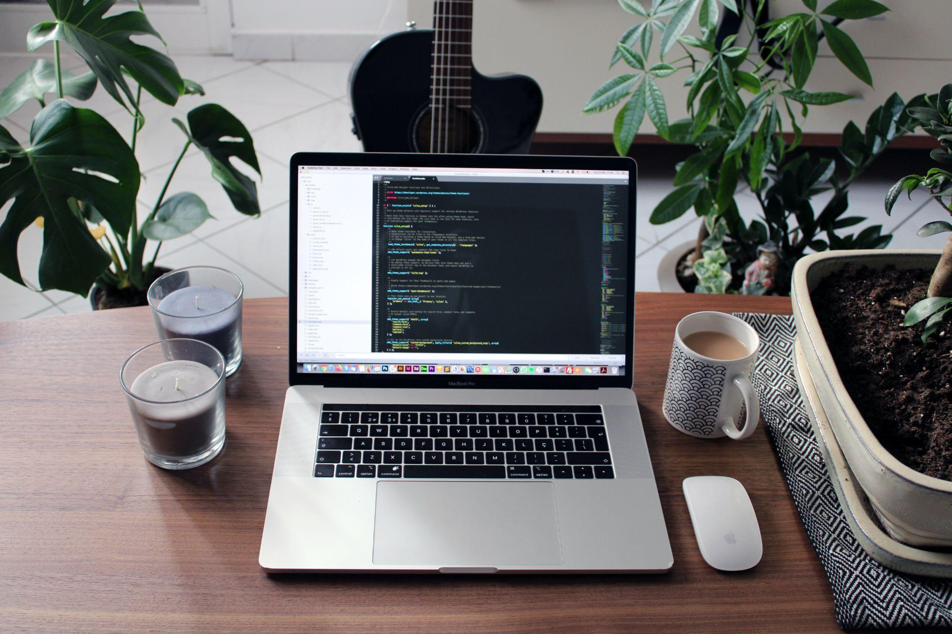
What is HTML?
Hyperlinks and Text Markup Language
Hypertext Markup Language
Hyperlinks Text Markup Language
Home Text Markup Language
Notes:
Photo by Nathan da Silva on Unsplash

Slide 11
What is HTML?
Hyperlinks and Text Markup Language
Hypertext Markup Language
Hyperlinks Text Markup Language
Home Text Markup Language
Notes:
Photo by Nathan da Silva on Unsplash

Slide 12

Why is it called index.html?
It is named after the index finger
Refer to the login page
Short for "indicate extension"
Refer to the default or home page
Notes:
Photo by Goran Ivos on Unsplash

Slide 13
Why is it called index.html?
It is named after the index finger
Refer to the login page
Short for "indicate extension"
Refer to the default or home page
Notes:
Photo by Goran Ivos on Unsplash

Slide 14
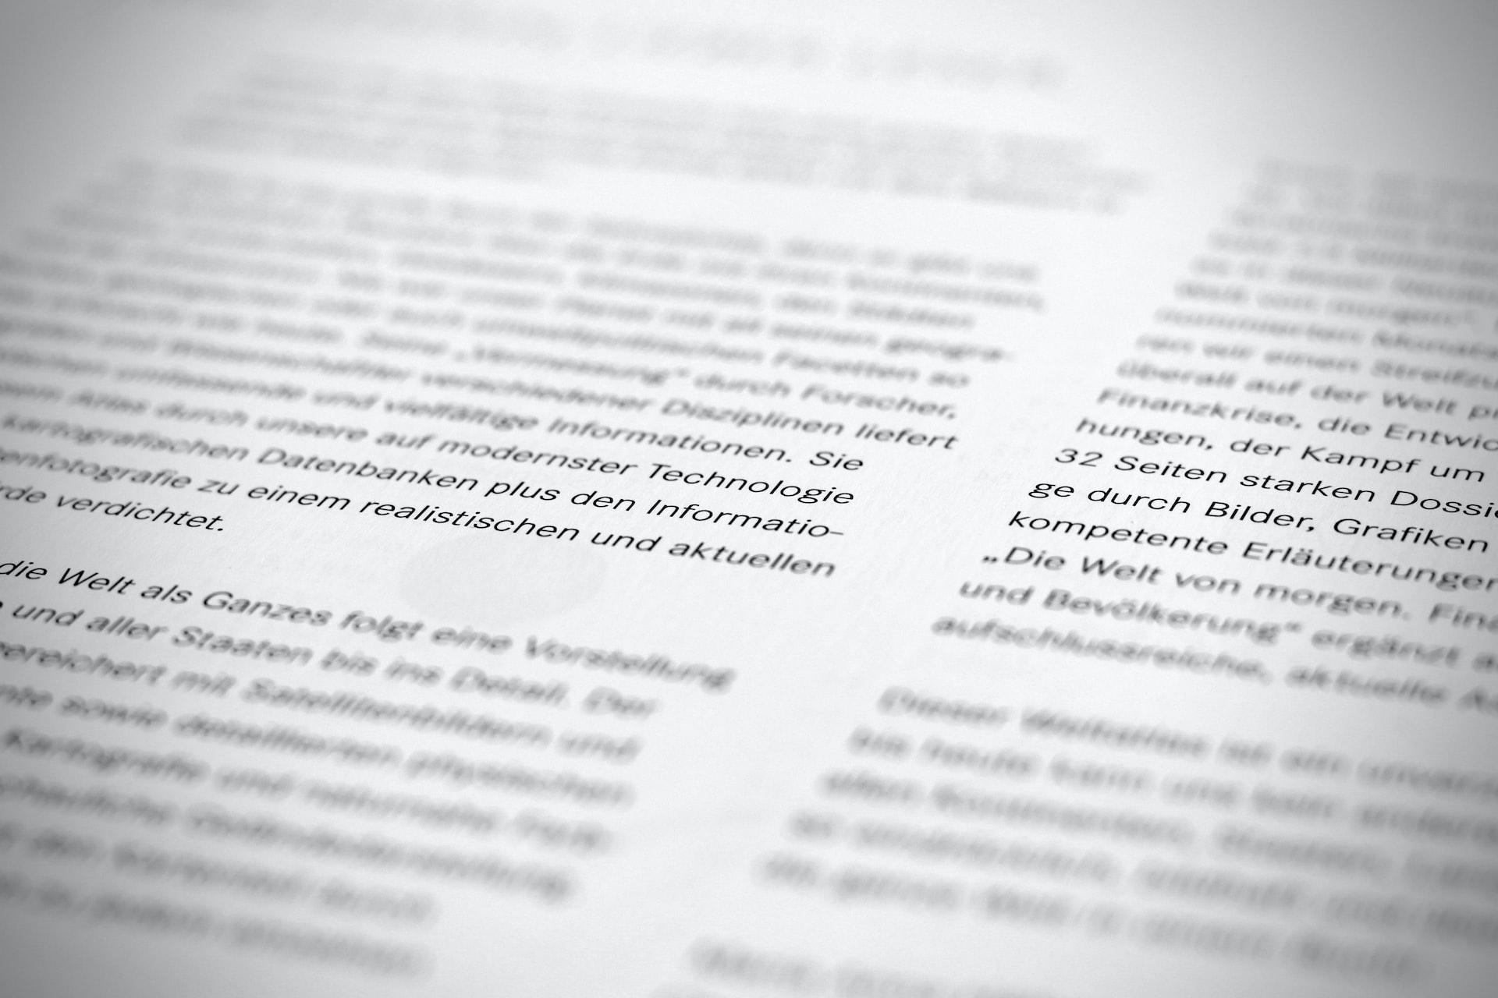
How do we create paragraph tag?
<p> </p>
<par></par>
<pg> </pg>
<para> </para>
Notes:
Photo by Finn Mund on Unsplash

Slide 15
How do we create paragraph tag?
<p> </p>
<par></par>
<pg> </pg>
<para> </para>
Notes:
Photo by Finn Mund on Unsplash

Slide 16
What do we call the text in between the paragraph tag?
<p> This is a paragraph of text.</p>
text
markup
content
tag
Notes:
Photo by Nathan da Silva on Unsplash

Slide 17
What do we call the text in between the paragraph tag?
<p> This is a paragraph of text.</p>
text
markup
content
tag
Notes:
Photo by Nathan da Silva on Unsplash

Slide 18
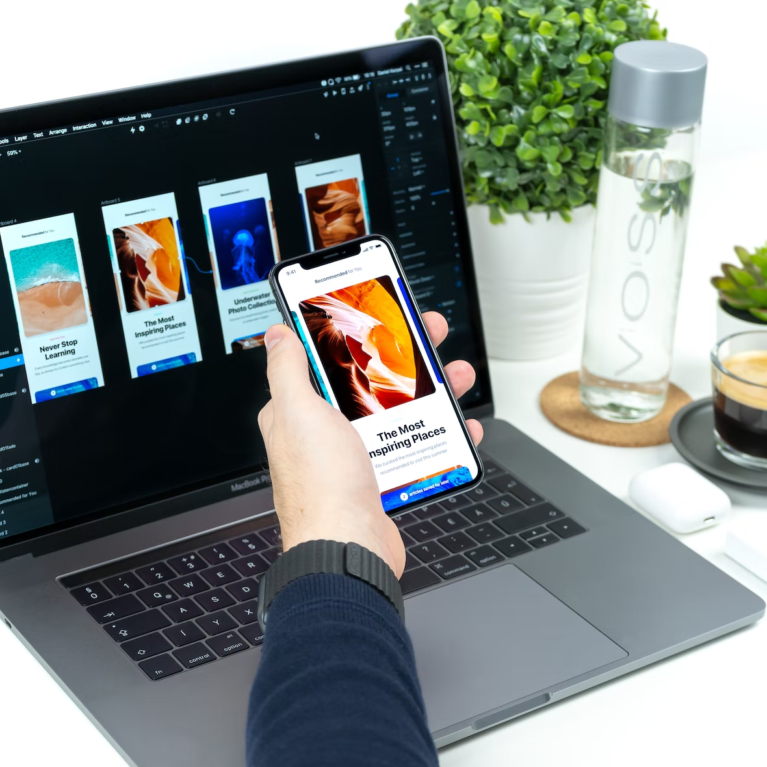
Styling Websites with CSS
Notes:
Image from: Unsplash

Slide 19
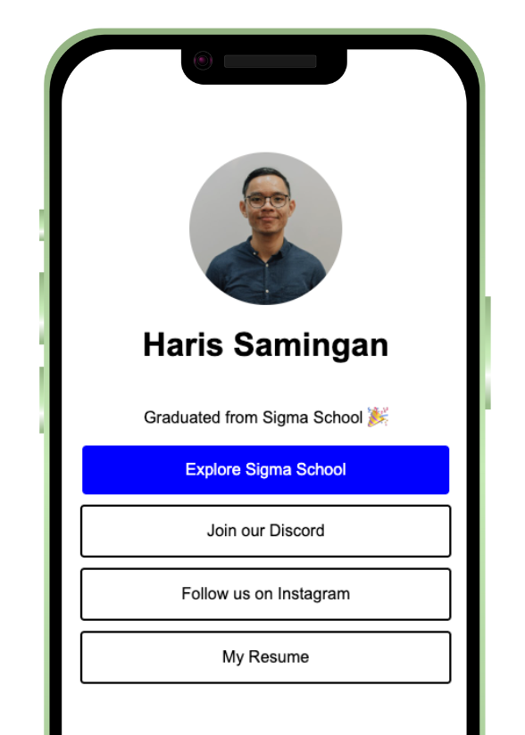

What you are building
It is a simple link-in-bio website that shows different links (including your resume
in Day 1)
What you are learning:
- Learn to style a website using CSS
- Add your profile picture for employers!
- Learn to create buttons and design them - Build a Link in Bio project
Demo project here.

Slide 20
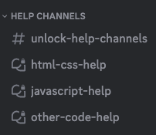
Need help?
We are happy to help with any issues, things you don’t understand in our Discord channel here.
Here is our full link:
https://discord.gg/yCrB7tfbhg
Once in discord, add your questions in our help channels.

Slide 21
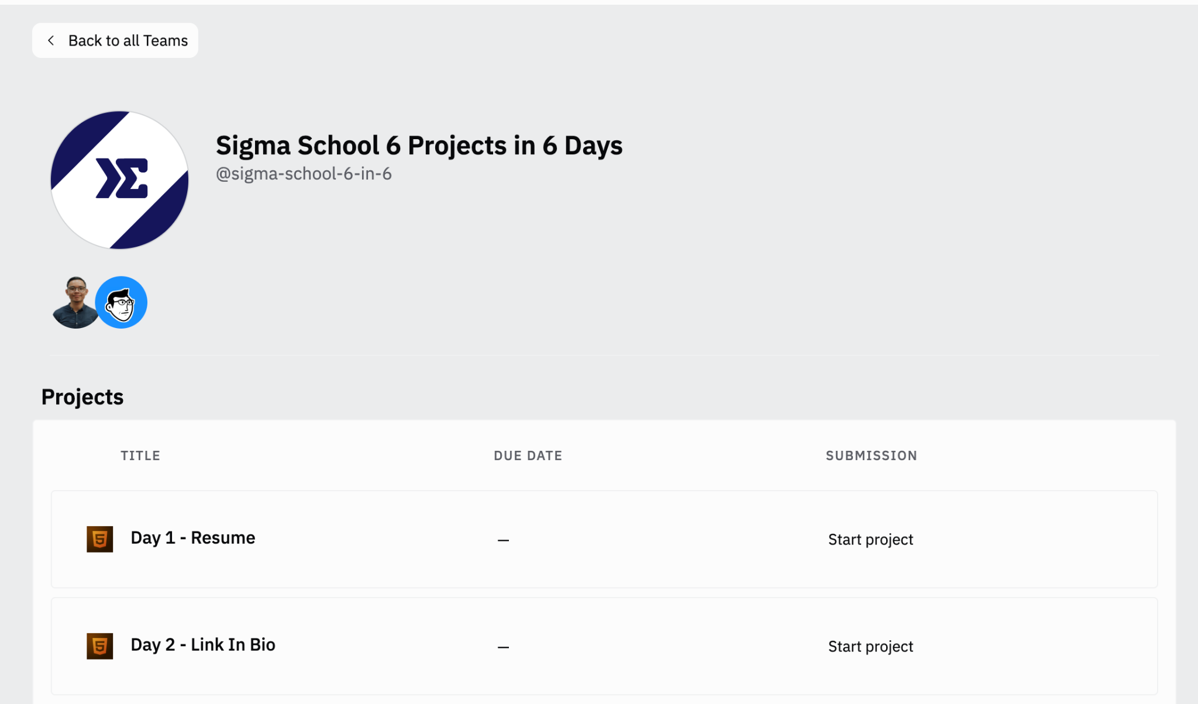

Go to our team dashboard: https://sig1.co/replit-6in6
You can click on Day 2 - Link in Bio:

Slide 22
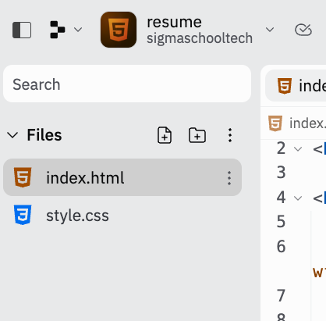
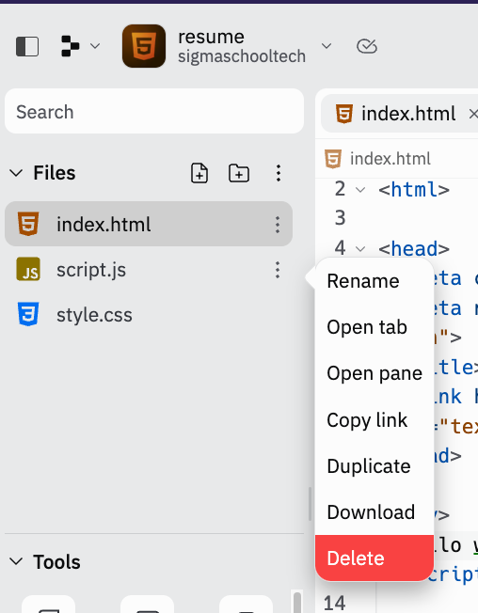

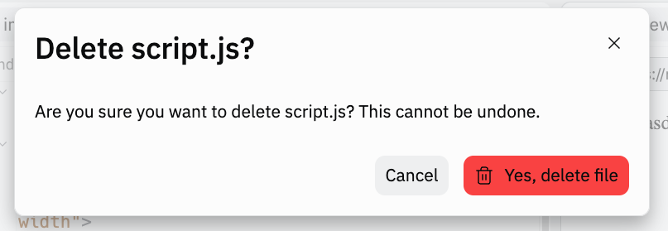
First, let’s delete the script.js. Why? We want to focus on learning HTML/CSS. JS will be taught in Day 3!
1
There should be no script.js!
2
3

Slide 23
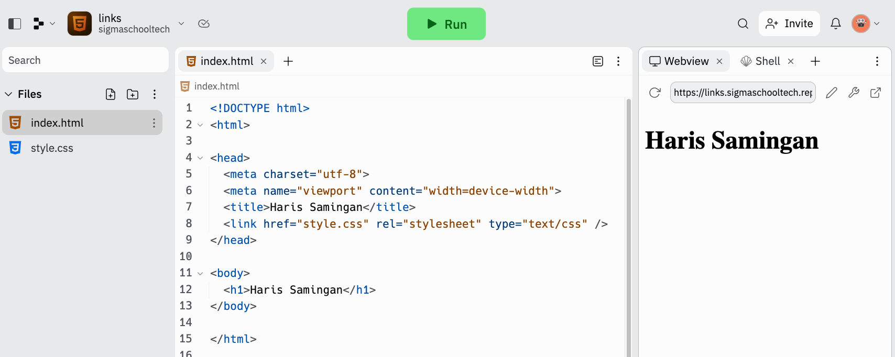
In the index.html, update the code¹ to this, and run the code². It should look like this³. We are going to change the font.
Change Haris Samingan to your name!
2
1
3
Notes:
<!DOCTYPE html>
<html>
<head>
<meta charset="utf-8">
<meta name="viewport" content="width=device-width">
<title>Haris Samingan</title>
<link href="style.css" rel="stylesheet" type="text/css" />
</head>
<body>
<h1>Haris Samingan</h1>
</body>
</html>

Slide 24
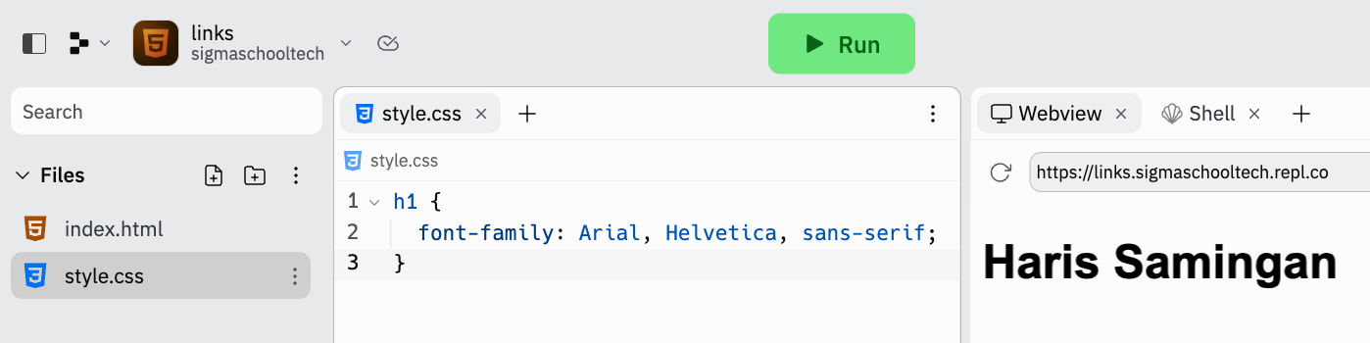
Go to style.css¹, update the code² to this, and run the code³. It should look like this⁴. Congrats! You have styled a text.
3
2
1
4
Developer tip on the next slide!
Notes:
h1 {
font-family: Arial, Helvetica, sans-serif;
}

Slide 25
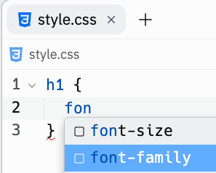
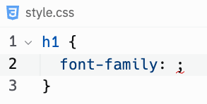
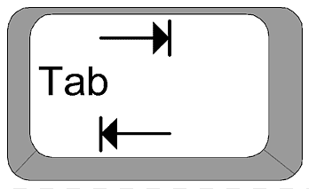
Lazy typing the whole code? Always have typing errors? Well, replit has auto complete! When typing font-family, there will be a suggestion box shown.
You can use your arrow keys to choose what you are about to type. Then, press the Tab key. Autocomplete!

Slide 26
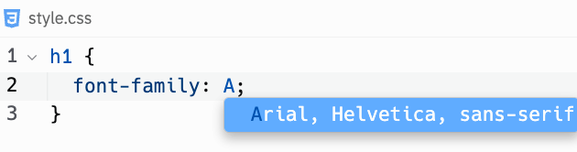
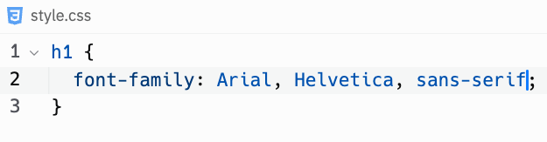
And since font-family Arial is a common font, we can auto complete it as well!

Slide 27
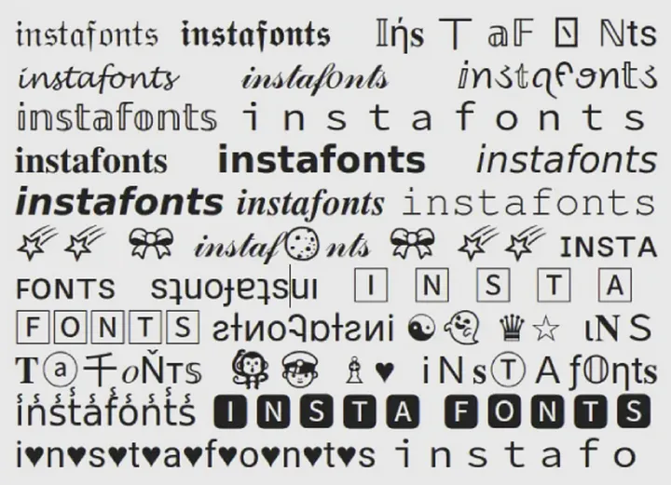
Try out other font family:
Arial, Helvetica, sans-serif
Verdana, Geneva, sans-serif
Times New Roman, Times, serif
Georgia, serif
Palatino, serif
Garamond, serif
Courier New, Courier, monospace
Lucida Console, Monaco, monospace
Impact, Charcoal, sans-serif
Tahoma, Geneva, sans-serif
Day 1
Image: instafonts.com

Slide 28
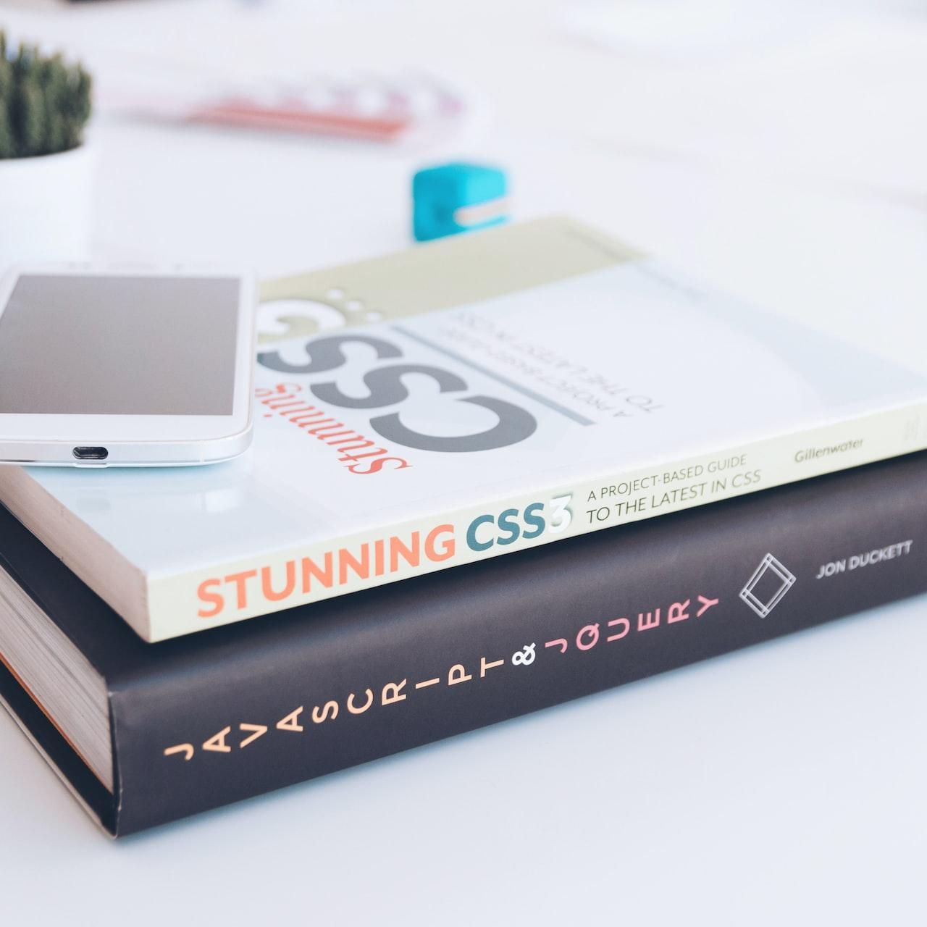
What is CSS?
Notes:
Photo by KOBU Agency on Unsplash

Slide 29
Cascading Style Sheet (CSS)
CSS is a way to describe how a website is presented and style.
We put our our styling in a .css file.
style.css is a convention or standard practice for naming a CSS file.
However, how does a CSS file change the appearance of a website?

Slide 30
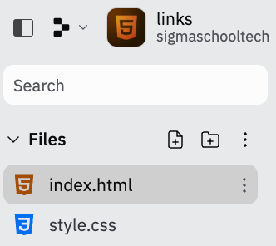
We link the CSS file to the HTML using…
<link> tag, which is used to define a hyperlink to an external file i.e style.css.
href="style.css" href attribute is the location of the file
rel="stylesheet" attribute describes the relationship between the HTML file to the linked file i.e style.css , which is a stylesheet.
type="text/css" attribute descript the MIME (Multipurpose Internet Mail Extensions) which helps the web browser to apply the CSS code to the HTML content.
Don’t delete any code. This is just explanation.

Slide 31
<meta>
Meta tag (not Facebook), provides metadata (or information) about a website.
charset="utf-8" attribute means character set of UTF-8. This is to show different letters and symbols, globally (including emojis 😜) meta name="viewport" content="width=device-width" means sets the width of the page to the device's screen size. Viewport refers to the visible area of a web page.
How did change how the heading looks like?
Don’t delete any code. This is just explanation.

Slide 32
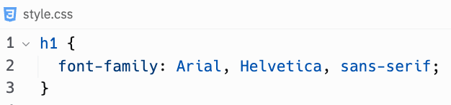
Styling a HTML element
FYI: We refer a visual thing (like heading) in a website an element.We refer the code to create the element as tags (like heading tag).
In the css file, we set the rule that all h1 (heading 1) elements has the font family of Arial. The browser will first try to display the text in Arial, then in Helvetica, and finally in a generic sans-serif font if neither Arial nor Helvetica is available.
Let’s go breakdown the CSS code.

Slide 33
CSS declaration breakdown
Selector (or selecting the specific HTML element)
Curly brackets to enclose CSS declaration
CSS property, with colon (:) at the end
CSS value, which sometimes have comma-separated values, and ends with semicolon (;)
Alright, now we understand the breakdown, let’s an image!

Slide 34
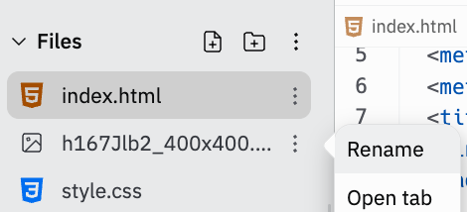
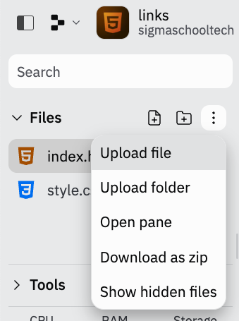
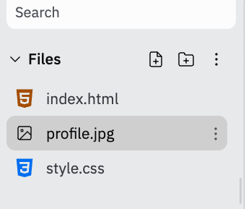
Upload an image to the project and name it profile.[file type*] e.g profile.jpg . Make sure it is a square image!
1
3
4
2
*File type includes jpg, jpeg, webp, png
5
Notes:
h1 {
font-family: Arial, Helvetica, sans-serif;
}

Slide 35
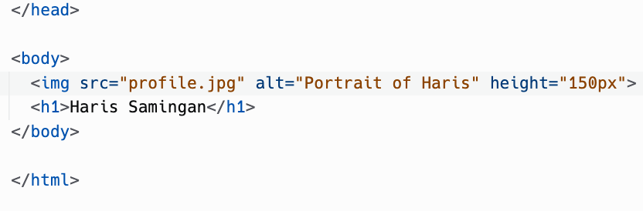
In our index.html, we are going to add the image with an img tag.
Don’t delete code outside this CodePart. Find this block of code and add the code in the red box. Watch video here if unclear
Notes:
h1 {
font-family: Arial, Helvetica, sans-serif;
}

Slide 36
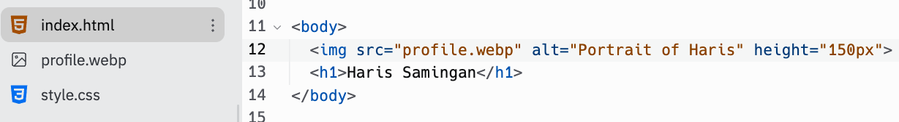
Make sure your image name is the same. For example, if your image is name profile.web:
Don’t delete code outside this CodePart. Find this block of code and add the code in the red box. Watch video here if unclear
Notes:
h1 {
font-family: Arial, Helvetica, sans-serif;
}

Slide 37
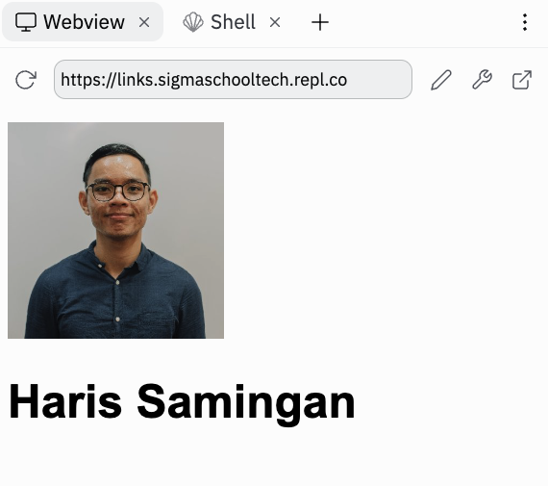
Your project should look like this! Let’s go through what happened.
Notes:
h1 {
font-family: Arial, Helvetica, sans-serif;
}

Slide 38
<img>
The image tag helps to show a photo.
The src attribute specifies the file path to the image file.
The height attribute controls how tall the image is, in pixels (px).
The alt attribute shows the alternate text for the image, if the image cannot be loaded. Also, it helps visually impaired users to “read” your image using screen reader.
Let’s try showing the alt text out!

Slide 39
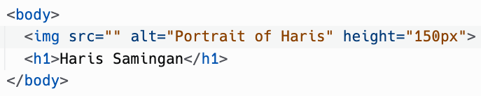

Remove the file name, and run the code. It should look like this:
Don’t delete code outside this CodePart. Find this block of code and update the code in the red box. Watch video here if unclear
Notes:
h1 {
font-family: Arial, Helvetica, sans-serif;
}

Slide 40
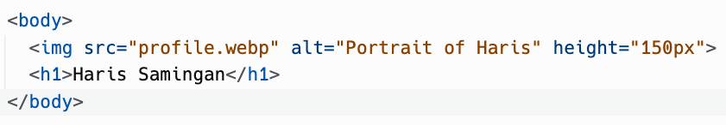
Let’s add the image file path back. And it should show your image! Now, we are going to change the image to a circle.
Don’t delete code outside this CodePart. Find this block of code and update the code in the red box. Watch video here if unclear
Make sure its the correct file name!
Notes:
h1 {
font-family: Arial, Helvetica, sans-serif;
}

Slide 41
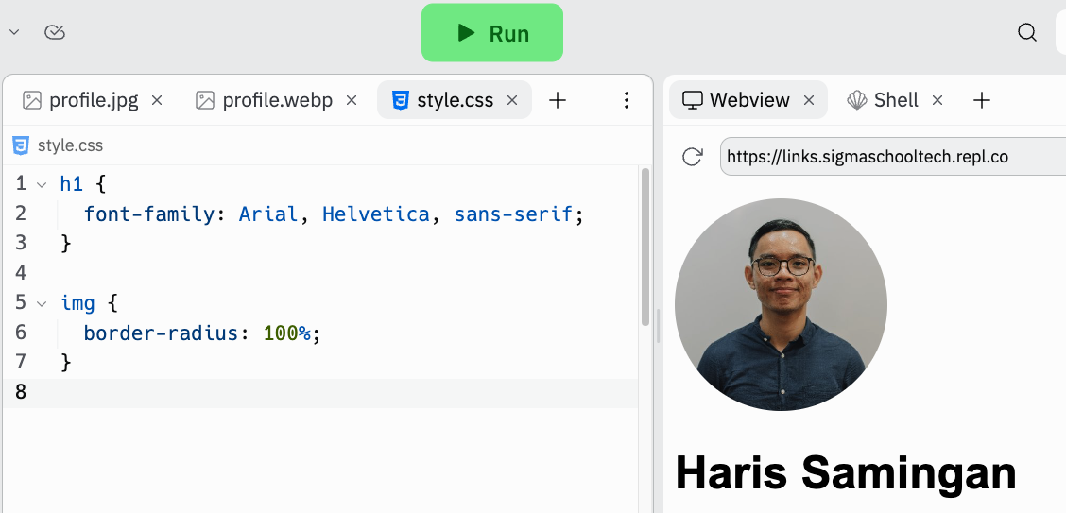
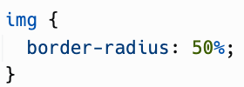
Go to style.css, update the code to this, and run the code. It should look like this. Good work! You made an image, a circle.
2
3
1
Notes:
h1 {
font-family: Arial, Helvetica, sans-serif;
}

Slide 42
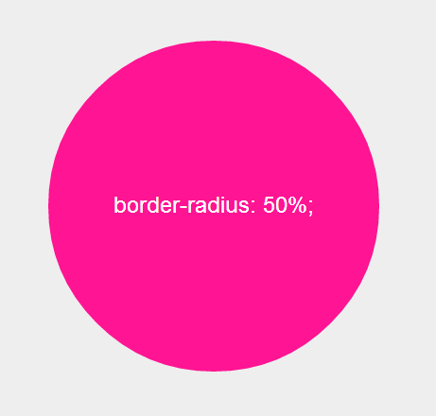
Border radius
CSS property that sets the rounded corners of an element.
50% is a value that specifies the size of the rounded corners as a percentage of the element's width and height.
It’s a little bit math. But know that if you have a equal height and width square, you will will have a perfect circle when
border-radius: 50%;
is applied. Try playing with different %!

Slide 43

Challenge
Create a paragraph text below that says: Graduated from Sigma School 🎉
It should look like this.

Slide 44

Progress
We have created the image, heading and paragraph.
Now, we are left centering the elements and creating the button.
Let’s get started with centering!

Slide 45

Centering in CSS
Day 1
Notes:
Photo by Goran Ivos on Unsplash

Slide 46
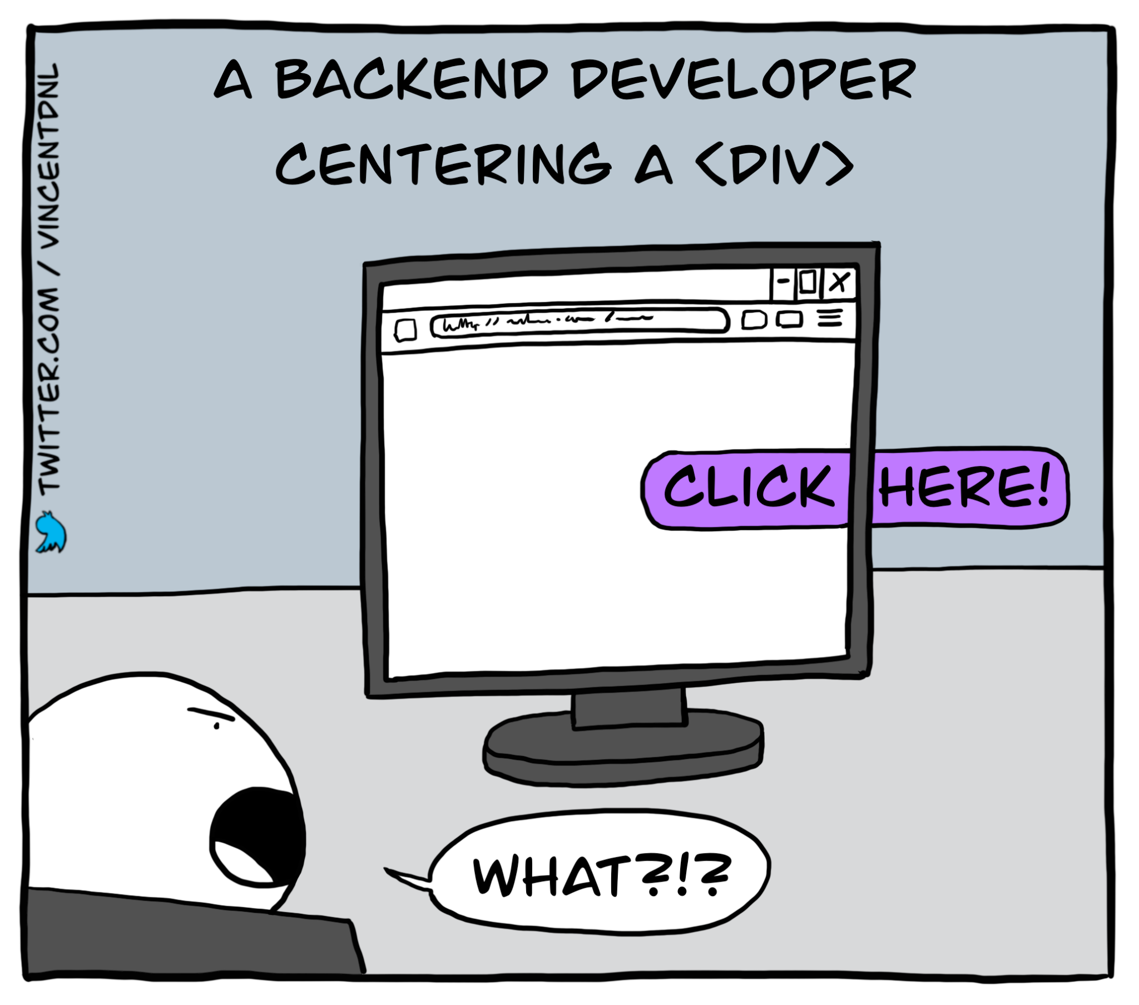
Centering in CSS is…
Confusing to a lot of developers.
Don’t worry, we only need to centre horizontally (from left to the centre)

Slide 47
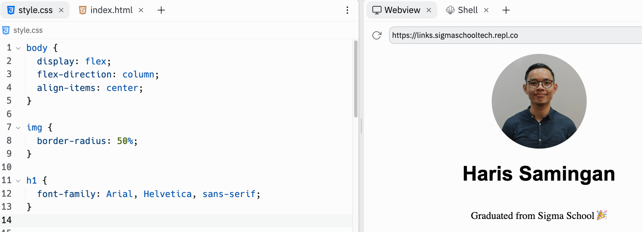
Go to style.css, update the code to this, and run the code. It should look like this. Good work! You centred your elements.
1
2
Notes:
h1 {
font-family: Arial, Helvetica, sans-serif;
}

Slide 48
Why rearrange the CSS code?
It makes your code readable. Developers appreciate code readability!
We arrange the CSS code according to their placement in the web browser.

Slide 49
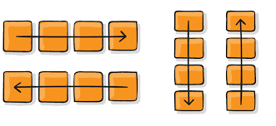
Display Flex
Allows the element to be laid out using the flexbox layout model.
Think of arranging elements in rows and columns
We call it one dimension layout
Don’t delete any code. This is just explanation.

Slide 50
Flex direction
Flex direction property specify whether you want to arrange your elements in a column or row.
Row
Column
Don’t delete any code. This is just explanation.

Slide 51
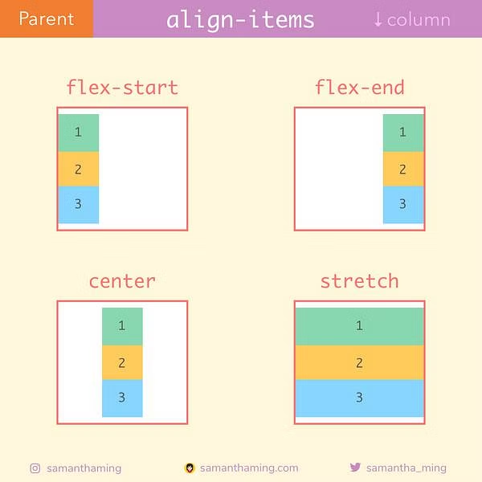
Align items
Sets where you want to put the column of elements, flex-start (left), flex-end (right), center, or stretch the elements to the browser’s width.
For now, we want to control our width of elements. We will stick with center.
Don’t delete any code. This is just explanation.

Slide 52
Progress
We have created the image, heading and paragraph, and centred them.
Now, we are left creating the button.
Let’s get started with creating buttons!

Slide 53

Creating buttons
Notes:
Photo by Austin Distel on Unsplash

Slide 54
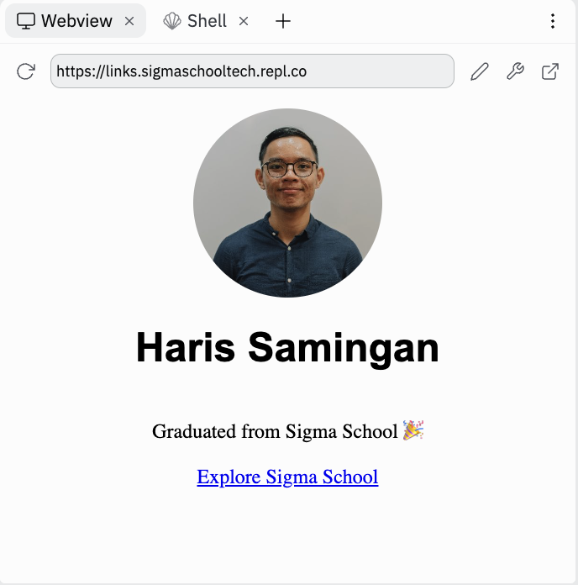
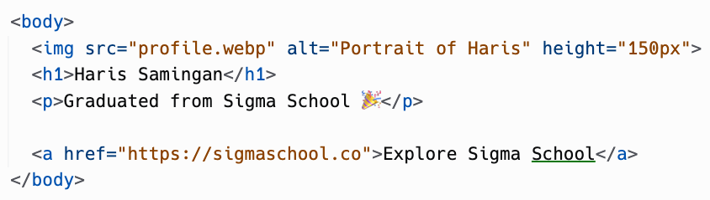
We first create a hyperlink. Go to index.html, update the code to this, and run the code. It should look like this.
Don’t delete code outside this CodePart. Find this block of code and add the code in the red box. Watch video here if unclear
Notes:
h1 {
font-family: Arial, Helvetica, sans-serif;
}

Slide 55

Test it to see it redirects to the page!
Notes:
h1 {
font-family: Arial, Helvetica, sans-serif;
}

Slide 56
Run the code again so that it shows your project
Notes:
h1 {
font-family: Arial, Helvetica, sans-serif;
}

Slide 57
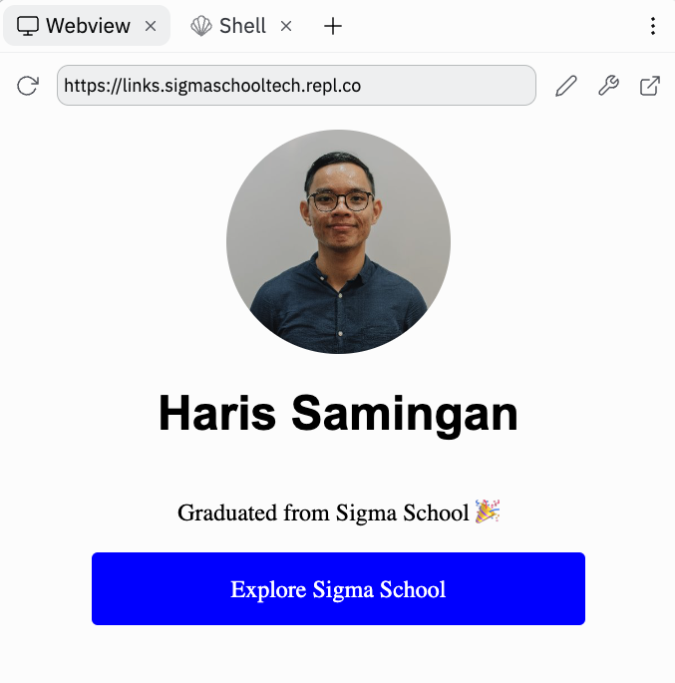
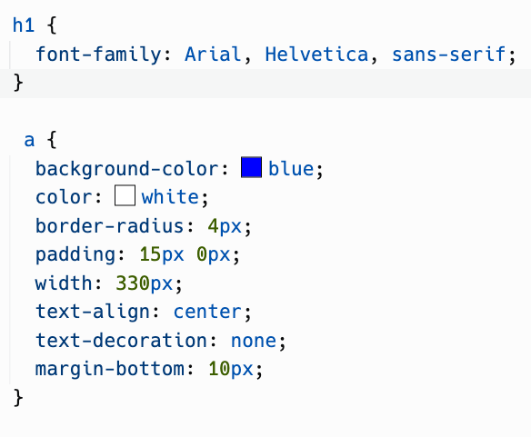
We are styling our link to a button. Go to style.css, update the code to this, and run the code. It should look like this.
Don’t delete code outside this CodePart. Find this block of code and add the code in the red box. Watch video here if unclear
Notes:
h1 {
font-family: Arial, Helvetica, sans-serif;
}

Slide 58

Background color
This gives the background color for the link.
Try changing to the color black!
Don’t delete any code. This is just explanation.

Slide 59
Color
This sets the text color. Is there a text-color CSS property? Nope.
Why? I honestly don’t know.
Don’t delete any code. This is just explanation.

Slide 60

Border radius
CSS property that sets the rounded corners of an element.
Don’t delete any code. This is just explanation.

Slide 61
Padding
Padding is space to fill up your element.
Let’s try experimenting with padding!
Don’t delete any code. This is just explanation.

Slide 62

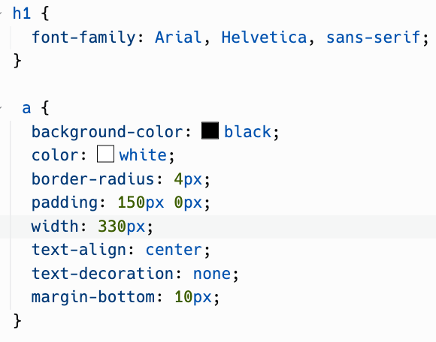
We are adding vertical padding. Go to style.css, update the code to this, and run the code. It should look like this.
Don’t delete code outside this CodePart. Find this block of code and add the code in the red box. Watch video here if unclear
Notes:
h1 {
font-family: Arial, Helvetica, sans-serif;
}

Slide 63

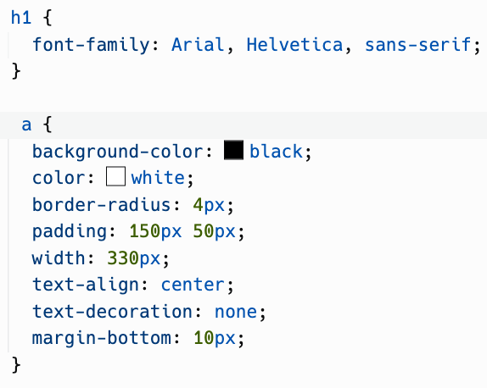
We are adding horizontal padding. Go to style.css, update the code to this, and run the code. It should look like this.
Don’t delete code outside this CodePart. Find this block of code and add the code in the red box. Watch video here if unclear
Notes:
h1 {
font-family: Arial, Helvetica, sans-serif;
}

Slide 64

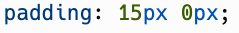
Let’s revert (go back) to our default padding. Update the code to this, and run the code. It should look like this.
Don’t delete code outside this CodePart. Find this block of code and add the code in the red box. Watch video here if unclear
Notes:
h1 {
font-family: Arial, Helvetica, sans-serif;
}

Slide 65
Width
Controls how wide a HTML element is.
Don’t delete any code. This is just explanation.

Slide 66
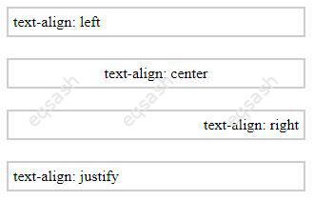
Text-align
The text-align property is used to set the horizontal alignment of text within an element.
Don’t delete any code. This is just explanation.

Slide 67


Text-decoration
We want to remove the underline that comes with the link. Therefore, we remove the underline decoration.
Default anchor link style
text-decoration: none;
Don’t delete any code. This is just explanation.

Slide 68
Margin
No margin
Amount of space between an elements. We can set which direction of margin we want to add.
margin-bottom: 10px;
Don’t delete any code. This is just explanation.

Slide 69
How to make all text same font?

Slide 70
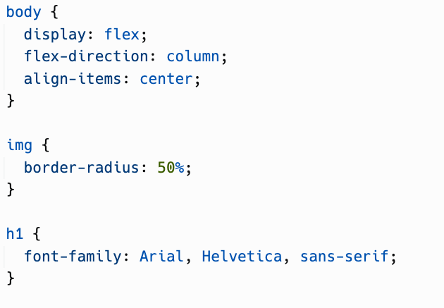
Move the font-family to the body selector. Here is how to move it like a developer, in the next slide!
Don’t delete code outside this CodePart. Find this block of code and add the code in the red box. Watch video here if unclear
Notes:
h1 {
font-family: Arial, Helvetica, sans-serif;
}

Slide 71
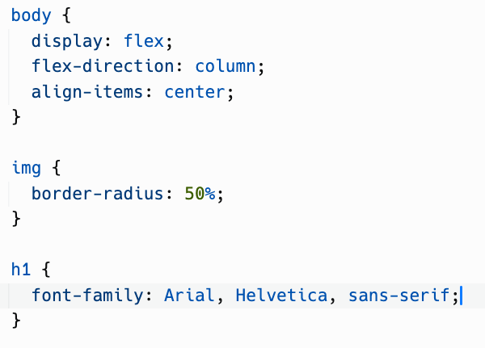
Make sure your text cursor is at the font family:
Notes:
h1 {
font-family: Arial, Helvetica, sans-serif;
}

Slide 72
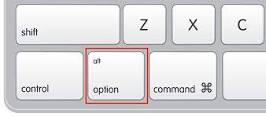


Hold down alt (for Windows) or option (for Mac).
Press the up arrow key once.
Notes:
h1 {
font-family: Arial, Helvetica, sans-serif;
}

Slide 73
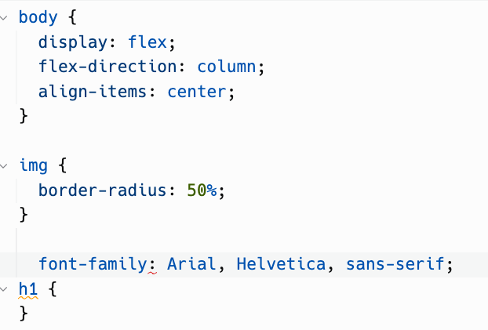
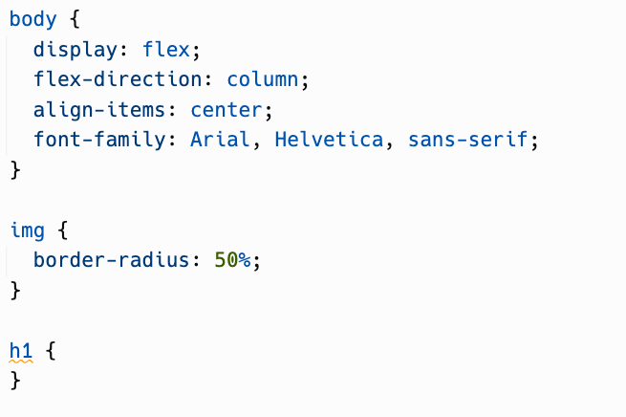
You should see the font family line of code moved up. Now try to move it right below align-items: center;
Notes:
h1 {
font-family: Arial, Helvetica, sans-serif;
}

Slide 74
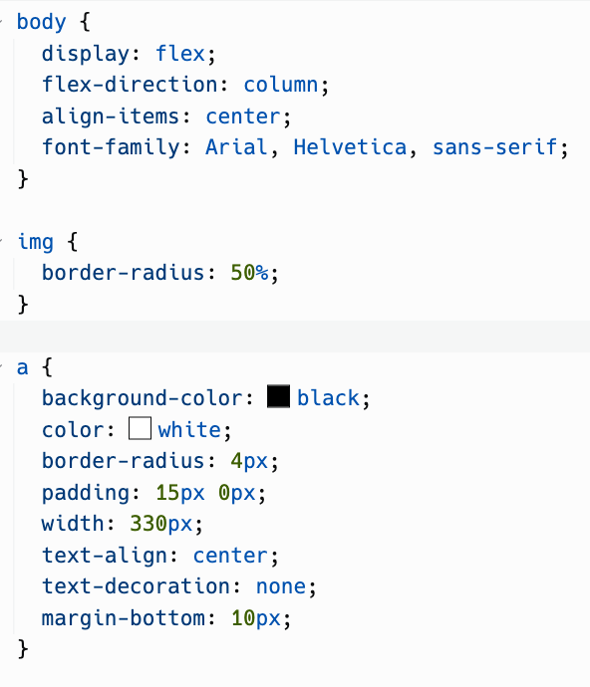

Remove the h1 selector, run the code, and it should look like this:
Notes:
h1 {
font-family: Arial, Helvetica, sans-serif;
}

Slide 75
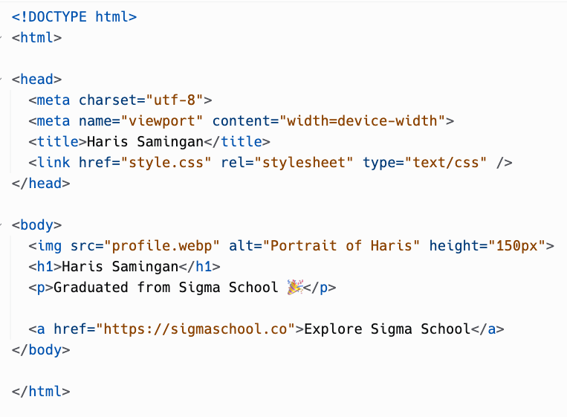
<html>
<head>
<body>
<img>
<h1>
<p>
<a>
HTML Hierarchy

Slide 76
<html>
<head>
<body>
<img>
<h1>
<p>
<a>
HTML Tree
HTML is a parent element of head, body.
Body is a parent element of img, h1, p, a.
And vice versa.
img, h1, p, a is the child element of body.
Head and body is the child element of HTML.
Just like a family tree…

Slide 77
<html>
<head>
<body>
<img>
<h1>
<p>
<a>
Inheritance
If html wants to have yellow text, its children element (head and body) would follow along.

Slide 78
<html>
<head>
<body>
<img>
<h1>
<p>
<a>
Inheritance
And since, head and body has yellow elements, its child (img, h1, p, a) will also have yellow text.
The style from a parent cascade (passes down) to its child element.
And since the body tag has font family of Arial…

Slide 79
<html>
<head>
<body>
<img>
<h1>
<p>
<a>
Inheritance
It’s child elements like h1 and p and a text font would follow along.
*The font shown on the right is not Arial. It’s exaggerated to explain better.

Slide 80

Challenge (Optional): outlined buttons
Notes:
Image from: Unsplash

Slide 81
Challenges (Optional)
Easy: Create more buttons that link to your resume (Day 1), LinkedIn, and many more.
Medium: Make buttons into outlined buttons instead!

Slide 82

Congratulations!
You have created a web application!
Share it in our Discord channel here.
More specifically under the Share Your Achievements section > #i-built-this channel.
Also don’t forget to push to GitHub! Recruiters are looking at Github as well. Refer next slide on how to push to GitHub!

Slide 83

Gain points!
Now that you have completed this module, you can gain points by doing this survey:
https://forms.gle/FJzRxgVw7fS2DMPY9
You can gain up to 16 points!
Currently, you can get a free Sigma T-shirt for 150 points.
There will be more freebies in the future ~
Not real. Picture is for illustration purposes.

Slide 84
Full code here:
https://replit.com/@sigmaschooltech/links#index.html

Slide 85
Day 2 completed!

